Slide 1
Introduction to CS 106A
Eric Roberts
CS 106A
January 4, 2009

Slide 2
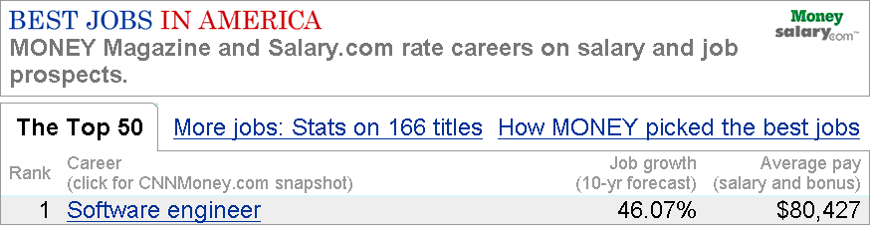
Why Study Computer Science
The computing industry offers some of the best employment opportunities for college graduates in the United States today:
  The number of jobs in the domestic software industry are at an all-time high and are projected to grow dramatically over the next decade.
  Salaries for newly minted B.S. graduates in Computer Science are high, sometimes exceeding the $100,000 mark.
  In 2005, Money magazine rated software engineer as the number one job in America.
  Employment in this area is vital for national competitiveness.
Employment
(thousands)
Top 10 job growth categories (2006-2016)
2006
2016
Growth
1.
Network systems and data communications analysts
262
402
53.4
2.
Personal and home care aides
767
1,156
50.6
3.
Home health aides
787
1,171
48.7
4.
Computer software engineers, applications
507
733
44.6
5.
Veterinary technologists and technicians
71
100
41.0
6.
Personal financial advisors
176
248
41.0
Google and Facebook are fighting hard to hire this year’s crop of computer science graduates, we’ve heard, and ground zero is Stanford. Most of the class of 2008 already have job offers even though graduation is months away.
Last year, salaries of up to $70,000 were common for the best students. This year, Facebook is said to be offering $92,000, and Google has increased some offers to $95,000 to get their share of graduates. Students with a Master’s degree in Computer Science are being offered as much as $130,000 for associate product manager jobs at Google.
7.
Makeup artists, theatrical and performance
2
3
39.8
8.
Medical assistants
465
148
35.4
9.
Veterinarians
62
84
35.0
10.
Substance abuse and behavioral disorder counselors
83
112
34.3
Source:
U.S. Department of Labor, Bureau of Labor Statistics, Employment Projections: 2006-16, December 2007.

Slide 3
Degree Production vs. Job Openings
160,000
140,000
Ph.D.
Master’s
120,000
Bachelor’s
100,000
Projected job openings
80,000
60,000
40,000
20,000
Engineering
Physical Sciences
Biological Sciences
Computer Science
Sources:
Adapted from a presentation by John Sargent, Senior Policy Analyst, Department of Commerce, at the CRA Computing Research Summit, February 23, 2004. Original sources listed as National Science Foundation/Division of Science Resources Statistics; degree data from Department of Education/National Center for Education Statistics: Integrated Postsecondary Education Data System Completions Survey; and NSF/SRS; Survey of Earned Doctorates; and Projected Annual Average Job Openings derived from Department of Commerce (Office of Technology Policy) analysis of Bureau of Labor Statistics 2002-2012 projections. See http://www.cra.org/govaffairs/content.php?cid=22.

Slide 4
Why Study Computer Science
The computing industry offers some of the best employment opportunities for college graduates in the United States today:
  The number of jobs in the domestic software industry are at an all-time high and are projected to grow dramatically over the next decade.
  Salaries for newly minted B.S. graduates in Computer Science are high, sometimes exceeding the $100,000 mark.
  In 2005, Money magazine rated software engineer as the number one job in America.
  Employment in this area is vital for national competitiveness.
Beyond its marketability, computer science is an intellectually challenging and highly creative discipline. It can also be a great deal of fun.
In CS 106A, we will cover many of the ideas and skills you need to begin a career in this field. At the same time, we try as hard as we can not to lose sight of the creativity and fun, making sure you have ample opportunities for both.

Slide 5
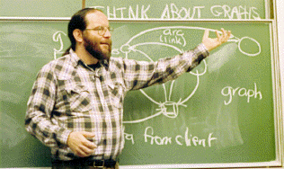
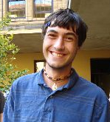
CS 106A Staff
Professor: Eric Roberts
eroberts@cs.stanford.edu
Office Hours (Gates 202):
Tuesdays 9:30-11:30
Wednesdays 4:30-5:30 (not this week)
Head TA: Chris Piech
piech@cs.stanford.edu
Office Hours (Gates 160):
Mondays 1:00-3:00
Tuesdays 3:00-4:00

Slide 6
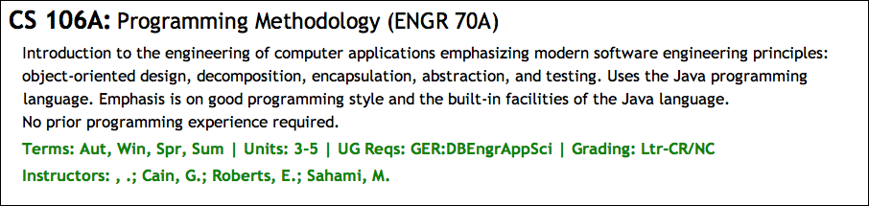
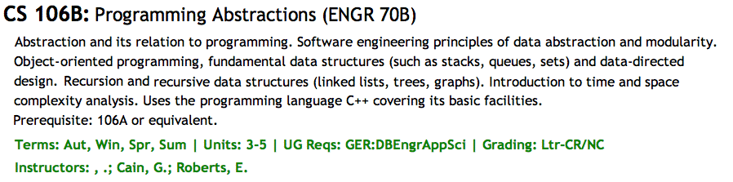
Is CS 106A the Right Course?

Slide 7
Important Administrative Notes
You must sign up for a section to be enrolled in the course. Section signups will start at 5:00P.M. on Thursday and close at 5:00P.M. on Saturday. Be sure to sign up during that time at
http://cs198.stanford.edu/section/
Undergraduates must take CS 106A for 5 units. Unfortunately, the default on Axess is 3 units, so make sure that you change this value as you register.
All handouts, assignments, lecture slides, and announcements are posted on the course web site at
http://cs106a.stanford.edu/
Both the midterm and the final are given at two scheduled times as shown in Handout #2. Special arrangements can be made for those who cannot make either time.

Slide 8


Syllabus—Week 1
January 4
6
8
Administration
CS and the Honor Code
Meet Karel the Robot
Simple Karel programs
Extending the Karel class
The concept of inheritance
Control structures in Karel
Problem-solving in Karel
Program decomposition
The idea of an algorithm
Read: Karel, Chapters 1-3
Read: Karel, Chapters 4-6

Slide 9
Syllabus—Week 2
11
13
15
Programming by example
Classes and objects
The Program hierarchy
Simple graphical objects
Variables and values
Arithmetic expressions
Common idioms
Control statements
Boolean data
Simple animations
Read: Java, Chapter 1
Due: HW #1 (Karel)
Read: Chapters 2 and 3
Read: Chapter 4

Slide 10
Syllabus—Week 3
18
20
22
Martin Luther King Day
Optional film:
Dr. King’s 1963 speech
I Have a Dream
Methods
The role of parameters
Pseudorandom numbers
The RandomGenerator class
Reading javadoc
Read: Chapter 5
Due: Karel contest
Read: Sections 6.1-6.2
Due: HW #2 (Simple Java)

Slide 11
Syllabus—Week 4
25
27
29
Objects and classes
Constructors
Inheritance
The acm.graphics package
The collage graphics model
Responding to mouse events
The Java listener model
Graphical structures
The GPolygon class
Creating compound objects
Read: Sections 6.3-6.6
Read: Sections 9.1-9.3
Read: Sections 10.1-10.3
Read: Section 9.4
Due: Problem Set #1

Slide 12
Syllabus—Week 5
February 1
3
5
Character data
Using Java’s String class
String manipulation
Problem-solving with strings
Data representation
Objects and memory
Read: Sections 8.1-8.4
Read: Section 8.5
Due: HW #3 (Breakout)
Read: Chapter 7

Slide 13
Syllabus—Week 6
8
10
12
Debugging strategies
Arrays in Java
More on arrays
Multidimensional arrays
The ArrayList class
Midterm Exam
Tuesday, February 9
3:15 or 7:00 P.M.
Due: Graphics contest
Read: Sections 11.1-11.5
Read: Sections 11.6, 11.8

Slide 14
Syllabus—Week 7
15
17
19
Presidents’ Day
(no class)
Pixel arrays
Image manipulation
Sorting and searching
Algorithmic analysis
File I/O
No reading
Read: Section 11.7
Read: Chapter 12
Due: HW #4 (Yahtzee)

Slide 15
Syllabus—Week 8
22
24
26
Swing interactors
The JComponent hierarchy
Action listeners
Java collection classes
The HashMap class
Iterators
Object-oriented design
Large-scale data structures
Data-driven programs
Read: Sections 10.5-10.6
Read: Chapter 13
Due: Problem Set #2

Slide 16
Syllabus—Week 9
March 1
3
5
Overview of Adventure!
The acm.gui package
The TableLayout class
Designing GUIs
Programming in the large
Software engineering
Programming patterns
Read: Adventure handout
Due: HW #5 (FacePamphlet)
Read: Sections 10.7-10.8

Slide 17
Dead Week and Beyond
8
10
12
Frontiers of computing
(optional)
Review session:
Sunday, March 14
7:00-9:00 P.M.
Due: HW #6 (Adventure)
Final Exam times:
Monday, March 15
Friday, March 19
12:15-3:15 P.M.

Slide 18
Assignments in CS 106A
Assignments in CS 106A are due at 5:00P.M. Assignments that come in after 5:00 will be considered late.
Everyone in CS 106A starts the quarter with two “late days” that you can use at any time you need some extra time. In my courses, late days correspond to class meetings, so that, if an assignment is due on Wednesday and you turn it in on Friday, that counts as one late day.
Extensions can be approved only by the TA, Chris Piech.
Assignments are graded by your section leader, who discusses your work in an interactive, one-on-one grading session.
Each assignment is given two grades: one on functionality and one on programming style. Style matters. Companies in Silicon Valley expect Stanford graduates to understand how to write code that other programmers can maintain.

Slide 19


The CS 106A Grading Scale
Functionality and style grades for the assignments use the following scale:
A submission so good it “makes you weep.”
Exceeds requirements.
Satisfies all requirements of the assignment.
Meets most requirements, but with some problems.
Some more serious problems.
Even worse than that.
Why did you turn this in?

Slide 20
Contests
CS 106A will have three contests as follows:
  The Karel Contest associated with Assignment #1
  The Graphics Contest associated with Assignment #3
  The Adventure Contest associated with Assignment #6
First prize in the contest is a score of 100% on one of the graded components of the course, typically the final exam.
As an additional incentive, entering any of the contests gives you chances to win an additional grand prize in a random drawing at the end of the quarter.
Entering a contest also earns “house points” for your class in the style of the Hogwarts School from Harry Potter.
Securing a runner-up prize or an honorable mention on any contest gives you additional chances in the random drawing, as does having an assignment submitted as a + + candidate.

Slide 21
Honor Code Rules
Rule 1:
You must indicate on your submission any assistance you received.
Rule 2:
You must not share actual program code with other students.
Rule 3:
You must not look at solution sets or program code from other years
Rule 4:
You must be prepared to explain any program code you submit.

Slide 22
Encouraging Academic Integrity
No one likes exams. Unfortunately, as long as the rate of Honor Code violations remains high, we have no real option.
This quarter, I will adopt the following strategy to encourage academic integrity. The weight of the final exam will be
15% + 5% for each Honor Code case filed this quarter
The weight assigned to the homework will be whatever is left after the announced weights are assigned to the various other components, subject to a minimum of 15%.
For example, if no Honor Code cases come up this quarter, the final will count for 15% and the homework will count for 60%. If, however, there are three cases (as there were the last time I taught 106A), the final will count for 30% and the homework for 45%. And so on . . .

Slide 23
Meet Karel the Robot
Karel the Robot was developed here at Stanford by Richard Pattis over 30 years ago. Since then Karel has given many generations of CS 106A students a “gentle introduction” to programming and problem solving.
Initially, Karel understands only four primitive commands:
Karel’s world is composed of streets and avenues numbered from the southwest corner. (As in Manhattan, streets run east-west and avenues run north-south.) In this world, Karel is facing east at the corner of 1st Street and 1st Avenue.
Karel’s world is surrounded by a solid wall through which it cannot move. Depending on the problem, there may also be walls in the interior of the world that block Karel’s passage.
The only other objects that exist in Karel’s world are beepers, which are small plastic cones that emit a quiet beeping noise. In this world, for example, I’ve added a beeper to the corner of 1st Street and 2nd Avenue.
move()
Move forward one square
turnLeft()
Turn 90 degrees to the left
pickBeeper()
Pick up a beeper from the current square
putBeeper()
Put down a beeper on the current square
3
+
+
+
+
+
2
+
+
+
+
+
1
+
+
+
+
+
1
2
3
4
5

Slide 24
Your First Challenge
How would you program Karel to pick up the beeper and transport it to the top of the ledge? Karel should drop the beeper at the corner of 2nd Street and 4th Avenue and then continue one more corner to the east, ending up on 5th Avenue.
3
+
+
+
+
+
2
+
+
+
+
+
1
+
+
+
+
+
1
2
3
4
5

Slide 25
The End

Slide 26
Meet Karel the Robot
Karel the Robot was developed here at Stanford by Richard Pattis over 30 years ago. Since then Karel has given many generations of CS 106A students a “gentle introduction” to programming and problem solving.
3
+
+
+
+
+
2
+
+
+
+
+
1
+
+
+
+
+
1
2
3
4
5

